Slide 1
Our Retail Store Network
A multi-channel retail operation spanning five strategic locations across Portugal, serving over 21,000 active customers with nearly 50,000 annual transactions.
5
21,220
Store Locations
Active Customers
Lisbon, Porto, Faro, Coimbra & Online
Across all channels
49,601
124,335
Total Transactions
Units Sold
Completed orders processed
Across all product categories
Lisbon Flagship
Porto Center
Faro Outlet
Primary market anchor — highest transaction volume and brand presence in the capital.
Northern Portugal hub serving the Porto metropolitan area and surrounding region.
Southern Portugal presence; highest-margin store in the network at 57.72%.
Coimbra Boutique
Online Channel
Central Portugal market with strong customer loyalty and consistent transaction flow.
Digital retail arm extending geographic reach beyond physical store footprints.

Slide 2
Executive Summary & KPI Overview
The network delivers strong baseline profitability at 57.26% gross profit margin on $11.1M net revenue, with an average order value of $224.67 signaling healthy per-transaction economics.
Revenue Performance
Profitability Metrics
$13,077,986.70 Total Gross Revenue
$11,143,914.90 Total Net Revenue
$1,934,071.80 Discount Impact
Promotional adjustments represent approximately 14.8% of gross revenue — within a healthy range for a multi-channel apparel retailer.
$6,380,752.83 Total Gross Profit
57.26% Blended Profit Margin
$224.67 Average Order Value
High margin consistency across all five channels indicates disciplined cost management and a well-positioned product mix relative to cost of goods.
$11.1M
57.26%
Net Revenue
Profit Margin
After promotional adjustments
Blended across all channels
$224.67
21,220
Avg. Order Value
Active Customers
Per completed transaction
Generating 49,601 transactions

Slide 3
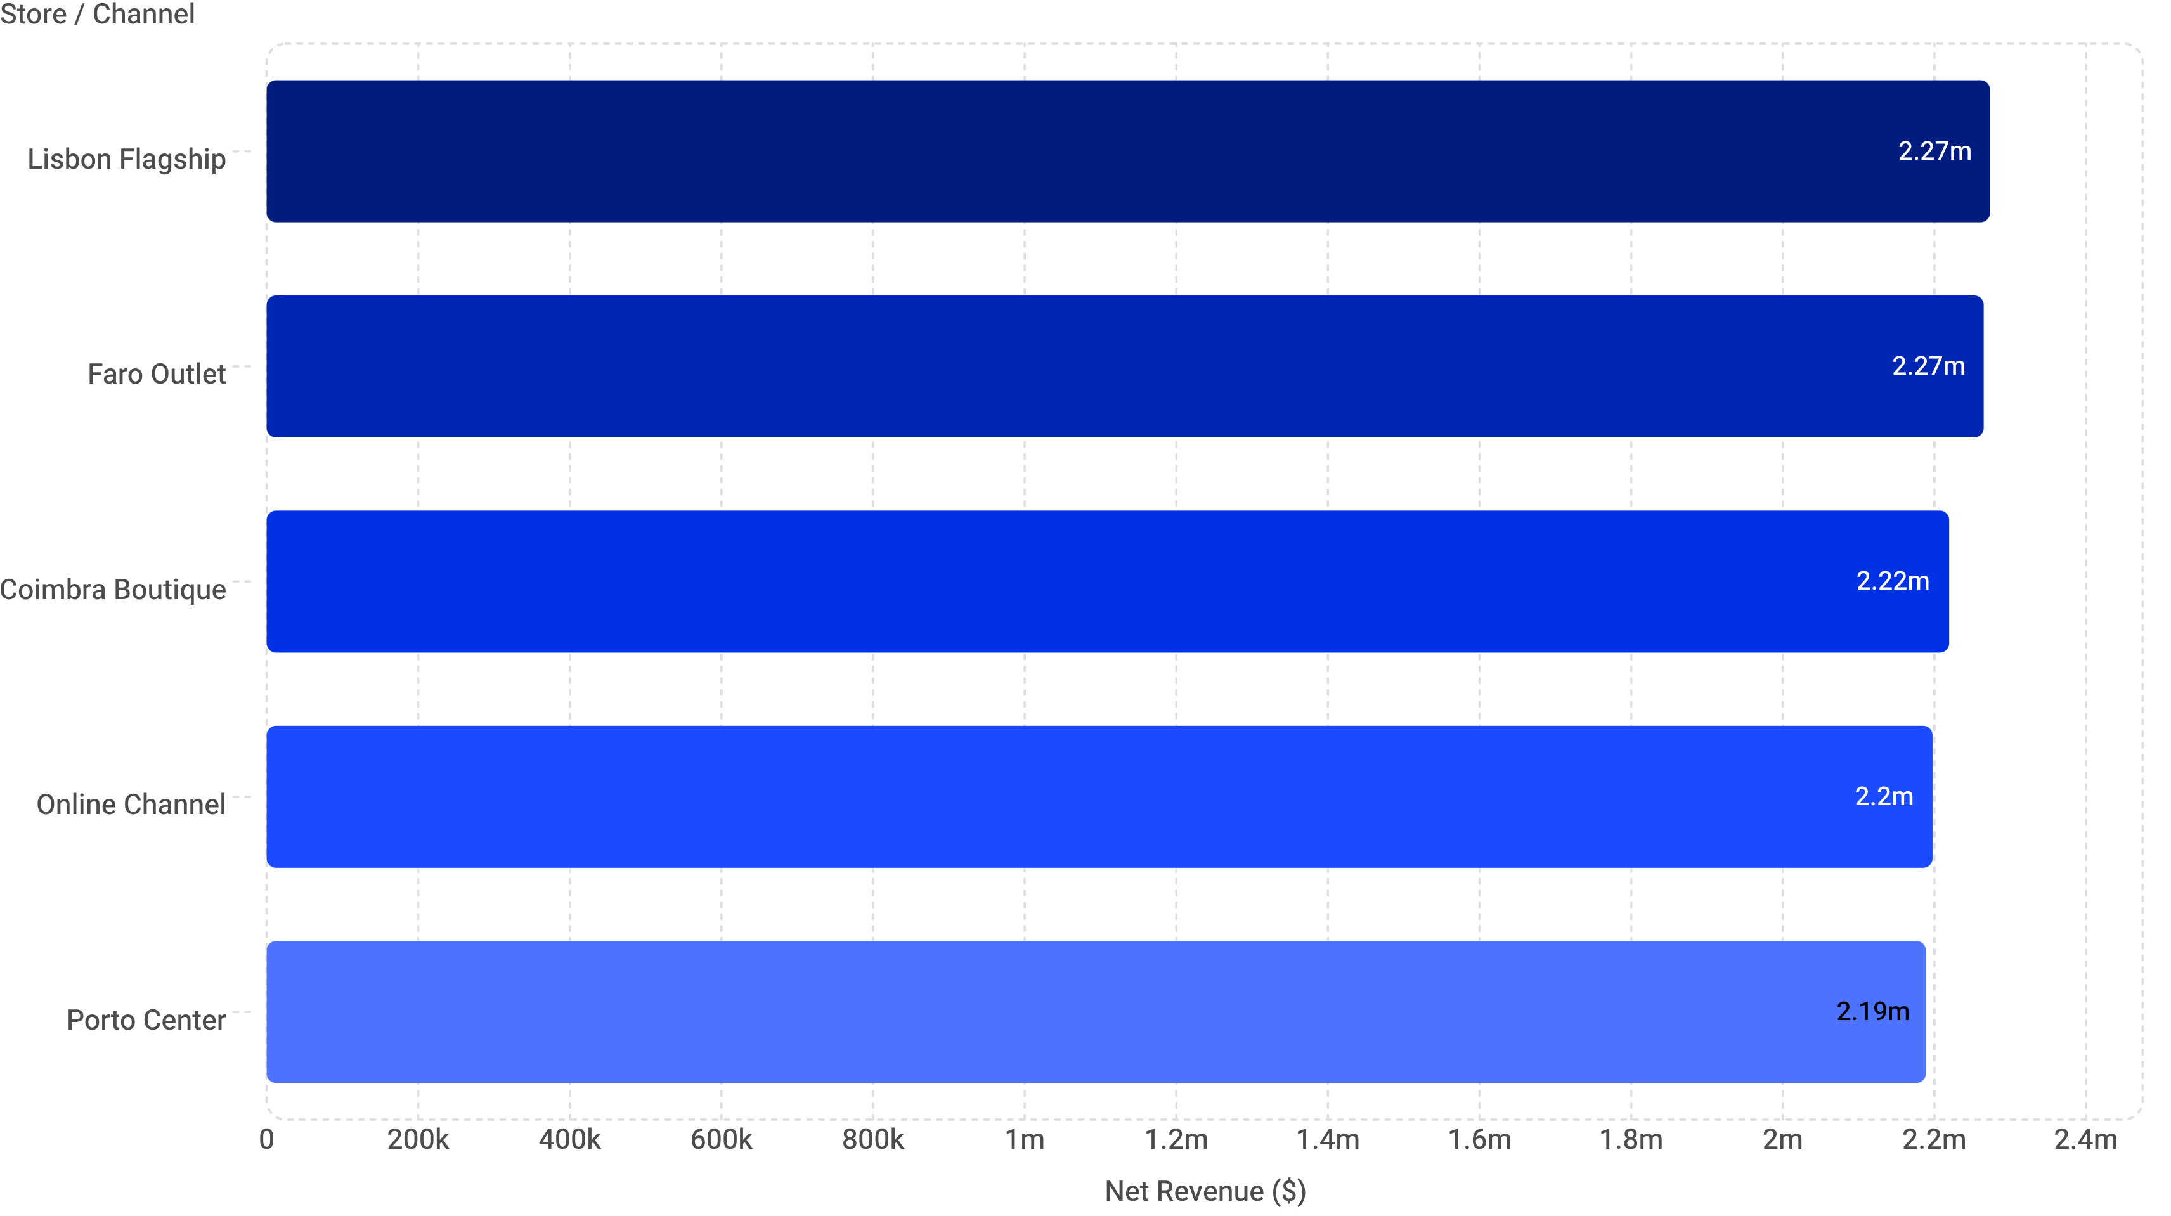
Store Channel & Regional Performance
Net revenue is remarkably evenly distributed across all five channels — a range of just ~$84K between highest and lowest — while margin variance reveals meaningful operational differences worth investigating.
Store / Channel | Net Revenue | Gross Profit | Transactions | Margin | Rank
Faro Outlet (S003) | $2,265,002.15 | $1,307,478.49 | 9,880 | 57.72% | #1
Online Channel (S004) | $2,197,506.81 | $1,262,092.69 | 9,833 | 57.43% | #2
Porto Center (S002) | $2,188,650.81 | $1,249,484.93 | 9,929 | 57.09% | #3
Lisbon Flagship (S001) | $2,273,277.72 | $1,297,920.84 | 10,114 | 57.08% | #4
Coimbra Boutique (S005) | $2,219,477.41 | $1,263,775.88 | 9,845 | 56.94% | #5
Faro Outlet leads all channels on margin (57.72%) despite ranking 2nd on absolute revenue — indicating superior cost discipline and/or a favorable product mix versus Lisbon Flagship.

Slide 4
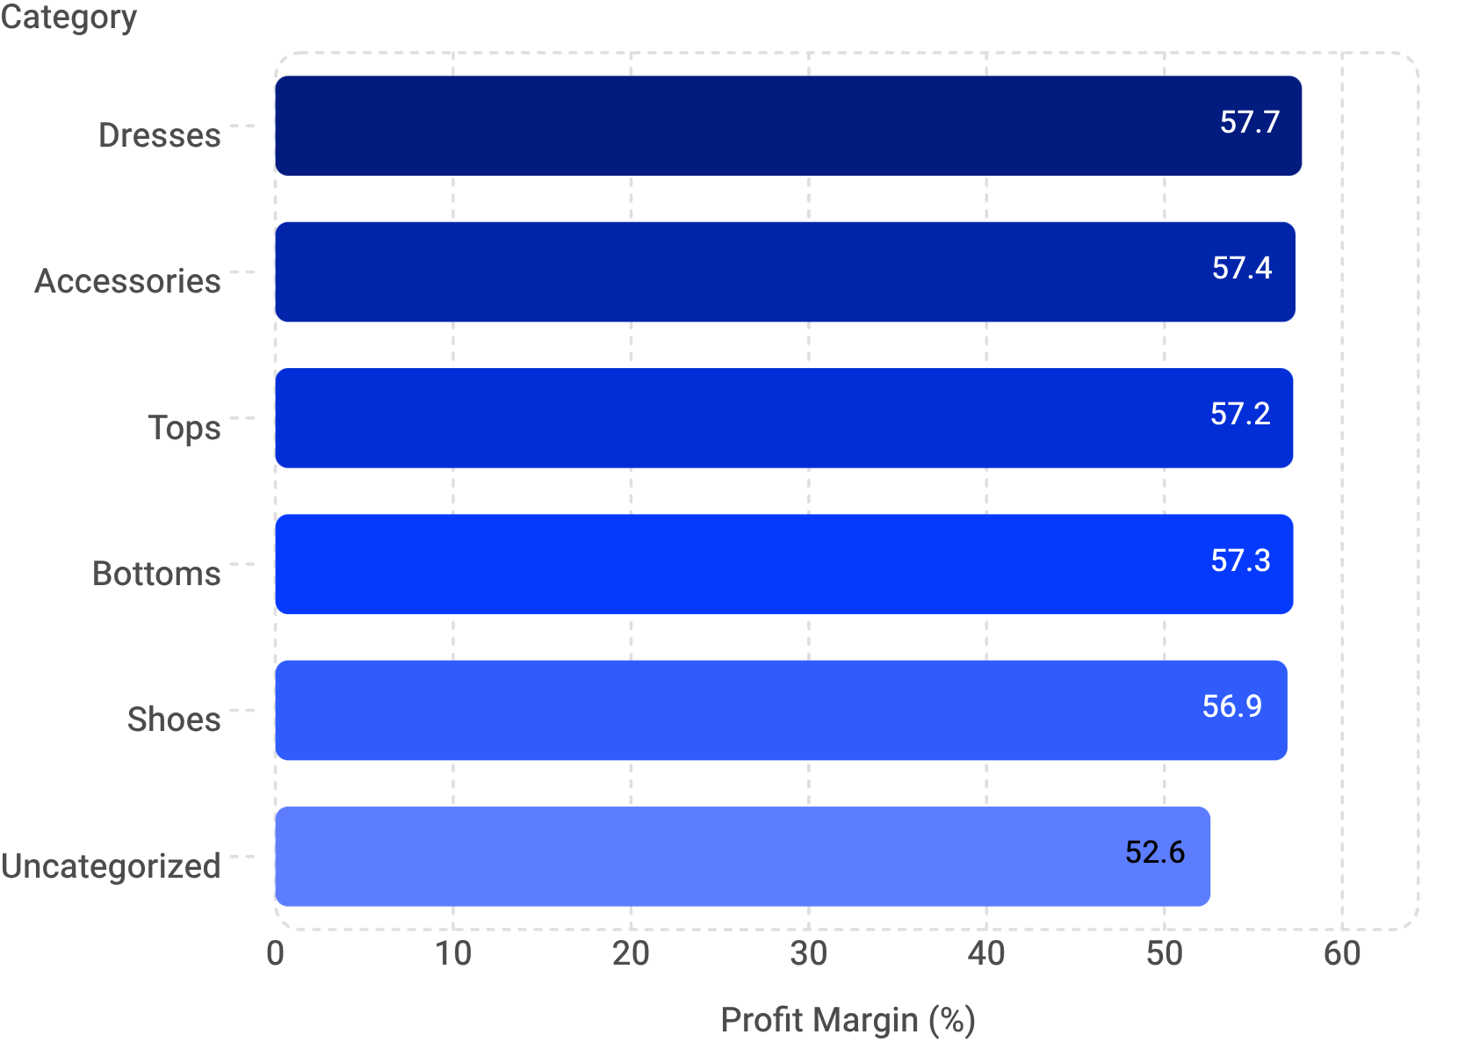
Product Category Profitability Analysis
Five core categories each contribute roughly $2.18M–$2.23M in revenue with tight margin clustering between 56.92% and 57.73%. An uncategorized segment flags a data integrity issue requiring immediate remediation.
Category | Revenue | Gross Profit | Units | Margin
Accessories | $2,225,923 | $1,276,928 | 24,950 | 57.37%
Shoes | $2,225,438 | $1,266,802 | 24,661 | 56.92%
Dresses | $2,207,110 | $1,274,267 | 24,453 | 57.73%
Tops | $2,204,974 | $1,262,157 | 24,506 | 57.24%
Bottoms | $2,176,173 | $1,245,750 | 24,577 | 57.25%
Uncategorized | $104,297 | $54,848 | 1,188 | 52.59%
Accessories and Shoes lead on absolute unit volume (24,950 and 24,661 respectively), making them the primary levers for revenue scale. Dresses command the highest margin at 57.73%, positioning the category as the most efficient profit generator per dollar of revenue.

Slide 5
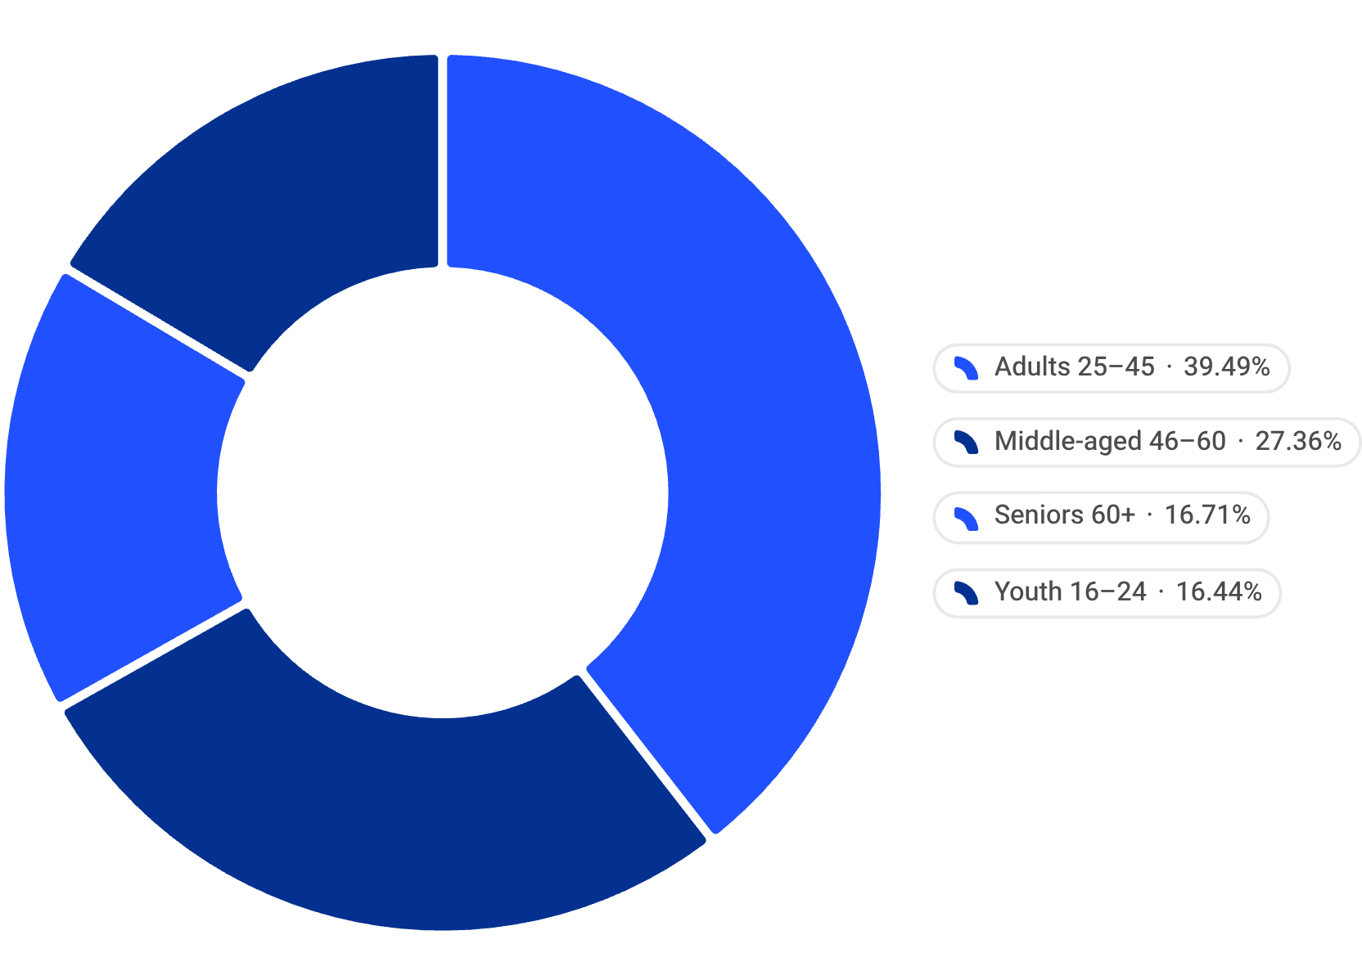


Customer Demographics & Spending Patterns
The Adults 25–45 segment drives 38.04% of net sales from 8,315 customers — the single most valuable cohort in the network. Geographic concentration in Lisbon, Faro, and Braga signals where localized marketing investment will yield highest returns.
Revenue by Age Segment
Segment Detail
Adults (25–45) — Primary Engine
Middle-aged (46–60) — Secondary Core
$4,239,138.71 | 8,315 customers | 38.04% of net sales
Highest spending per customer; core loyalty and campaign target.
$2,936,750.29 | 5,859 customers
Established buyers with strong repeat-purchase behavior.
Seniors (60+)
Youth (16–24)
$1,793,240.56 | Balanced distribution
Consistent segment; sensitivity to product accessibility and service quality.
$1,765,183.26 | Balanced distribution
Growth opportunity via digital-first engagement and trend-driven assortment.
Top Cities by Revenue
City | Revenue
Lisbon | $2,227,743.52
Faro | $2,161,175.59
Braga | $2,156,463.27

Slide 6

Critical Data Quality Issue: Uncategorized Products
A data integrity gap exists across 463 transactions and 1,188 units that remain uncategorized — generating $104,297.47 in net revenue that cannot be attributed to any product category. This is not a theoretical concern: it directly undermines inventory allocation, category-level reporting, and strategic planning reliability.
The Problem at a Glance
Risk Dimensions
463 Transactions with no category assignment
1,188 Units untracked at category level
$104,297.47 in revenue with no category attribution
$54,847.61 in profit recorded at the lowest margin in the network (52.59%)
For context, categorized products range from 56.92% to 57.73% — uncategorized items trail by 4–5 percentage points, suggesting possible pricing anomalies or cost misallocations that reclassification would resolve.
1
Reporting Accuracy
2
Inventory Allocation
Category-level P&L statements are understated. Decisions on assortment, pricing, and promotions are made on incomplete data.
Without category attribution, reorder logic and stock distribution across stores cannot be accurately modeled.
3
Strategic Blind Spot
If uncategorized items belong to an already-tracked category, that category's true performance is being systematically undercounted.
Immediate Action Required: Audit and reclassify all 1,188 uncategorized units into appropriate product categories. Establish upstream data validation rules to prevent recurrence at point-of-sale or ERP entry.

Slide 7
Strategic Recommendations
Five priority actions derived directly from the performance data — spanning operational efficiency, product mix, customer targeting, data governance, and geographic investment.
Channel Efficiency: Replicate the Faro Model
1
Faro Outlet's 57.72% margin — the highest in the network — should be studied as an operational benchmark. Conduct a root-cause analysis of Faro's cost structure, product mix, and discount discipline, then apply transferable practices to Coimbra (56.94%) and Lisbon (57.08%) to close the margin gap.
Product Mix: Volume via Accessories & Shoes, Margin via Dresses
2
Accessories (24,950 units) and Shoes (24,661 units) are the volume leaders — prioritize inventory depth and promotional investment in these categories to sustain transaction flow. Dresses, with the highest margin at 57.73%, warrant targeted upsell and cross-sell strategies to maximize profit per customer visit.
Customer Targeting: Double Down on Adults 25–45
3
This segment generates $4.24M (38% of net revenue) from 8,315 customers. Develop a dedicated loyalty program, personalized communications, and exclusive product access to deepen retention and increase share-of-wallet within this highest-value cohort.
Data Hygiene: Resolve 463 Uncategorized Transactions
4
The $104.29K in unclassified revenue and 1,188 units represent a reporting liability. Immediately audit and reclassify, then implement upstream validation at POS and ERP level to enforce mandatory category tagging — ensuring future category performance data is complete and audit-ready.
Geographic Focus: Invest in Lisbon, Faro & Braga Markets
5
These three cities collectively represent the network's highest revenue concentration. Prioritize localized marketing campaigns, store events, and community partnerships in these markets. Braga's strong performance without a dedicated physical store signals a potential expansion opportunity worth evaluating.

